Slide 1


Flight Data AnaLYSIS
Rocky Yadav
22 July 2024

Slide 2

OUTLINE
INTRODUCTION
METHODOLOGY
CHARTS & FINDINGS
OVERALL FINDINGS AND IMPLICATIONS
CONCLUSION
SOME OTHER ANALYSIS

Slide 3

INTRODUCTION
ANALYSIS OF FLIGHT’S TICKET PRICE
OBJECTIVE
ANALYSING THE TOTAL NUMBER OF FLIGHT ON DIFFERENT PARAMETERS
ANALYSING THE MEAN PRICE ON DIFFERENT PARAMETERS

Slide 4

METHODOLOGY
Data Collection Source
https://drive.google.com/file/d/1mGY1doT8RRTgIS0eZsiexHOjUIel9pvo/view?usp=sharing
Data Exploration
Data Cleaning
Removing nulls
Removing outliers
Dropping Columns
Data Visualization
Conclusion

Slide 5
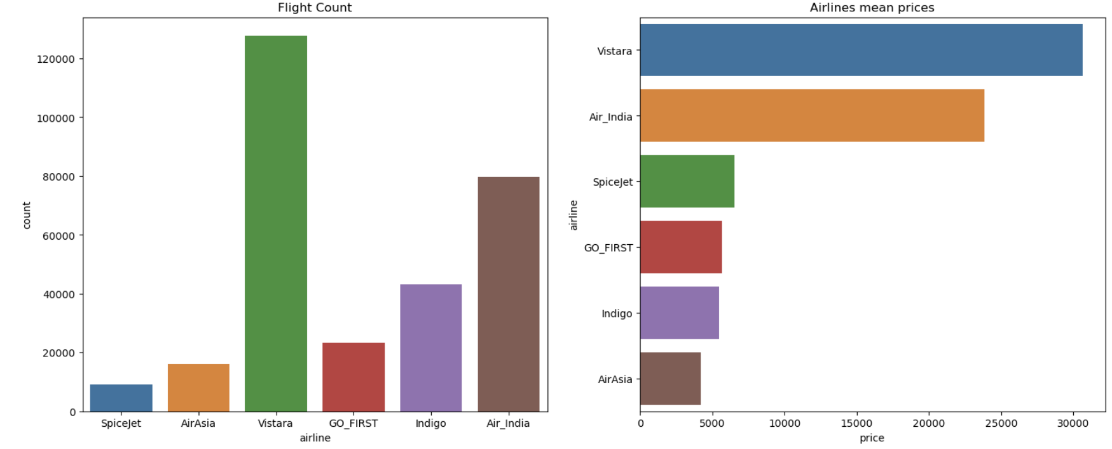
CHART AND FINDINGS
AIRLINE WISE ANALYSIS
Vistara operates maximum number of flights and Spicejet operates least
Mean price of vistara is highest and AirAsia having least

Slide 6
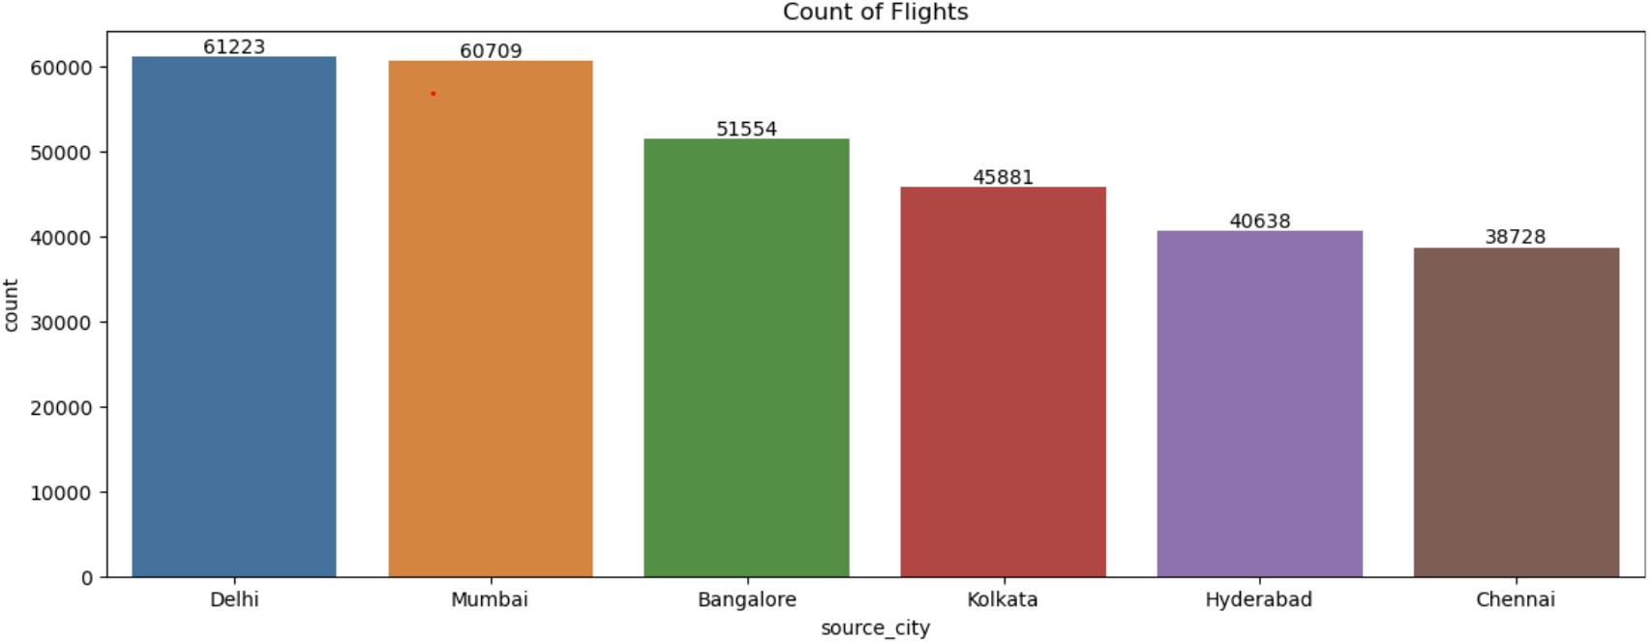
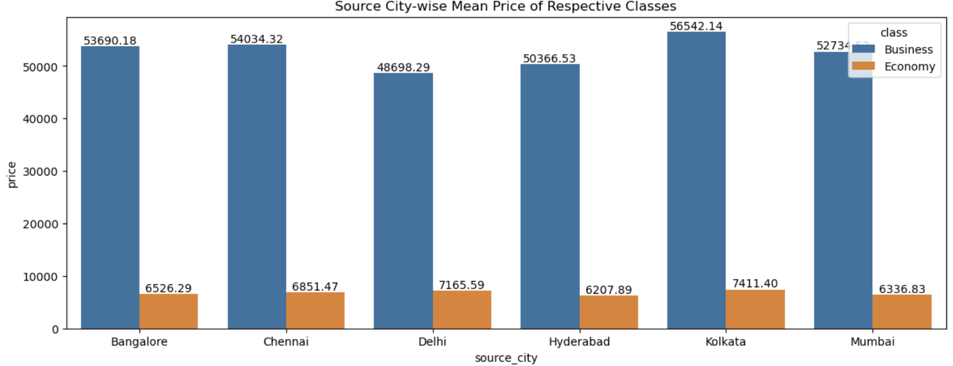
SoURCE CITY WISE ANALYSIS
Delhi is the source of most flights.
Mean Price of both class is highest at Kolkata.

Slide 7
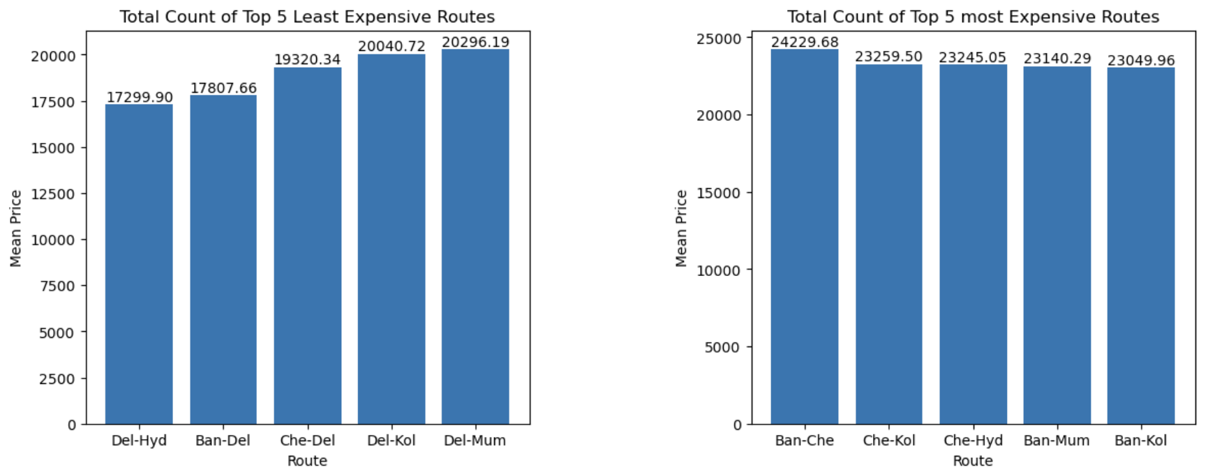
CHART
ROUTE WISE ANALYSIS
Delhi - Hyderabad is the Least Expensive route.
Banglore - Chennai is Most Expensive Route.

Slide 8
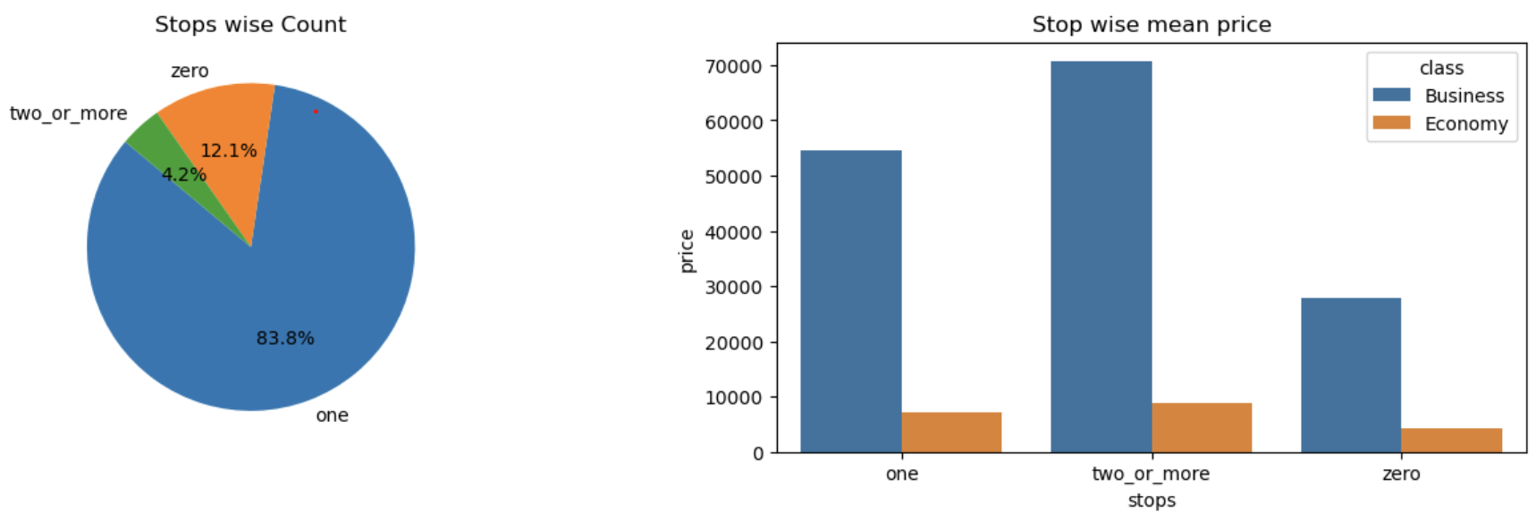
Stops Wise Analysis
CHART
Most Flights have one Stops.
Price of flight having one stop is highest.

Slide 9
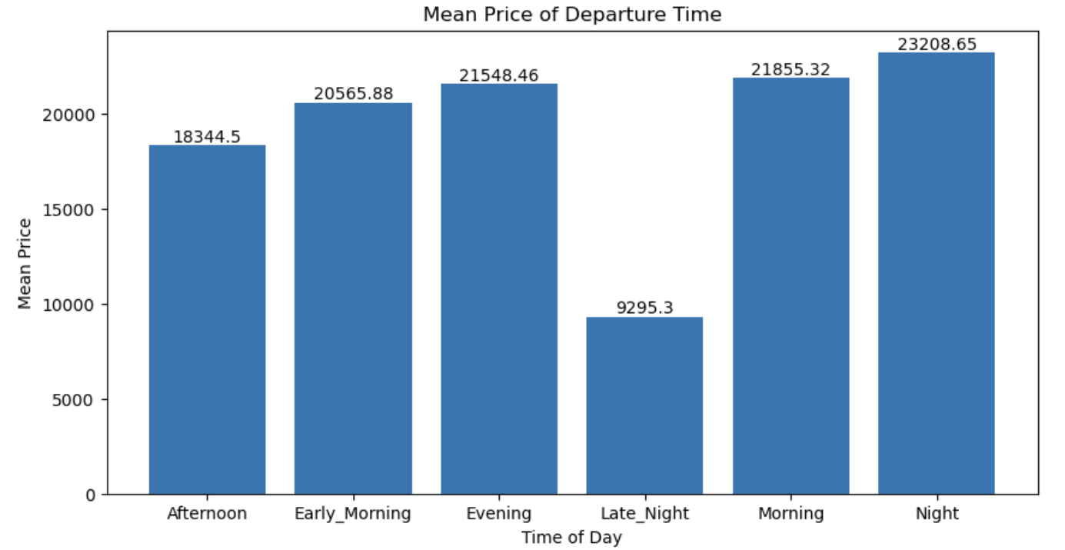
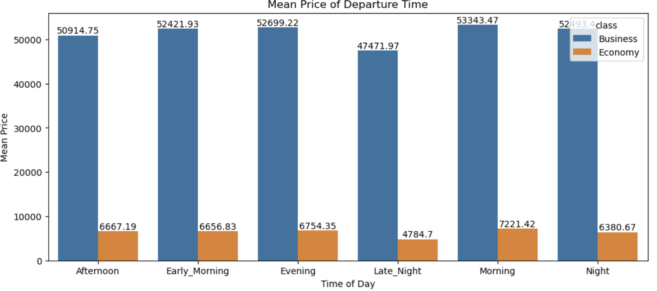
Time (OF DAY ) WISE ANALYSIS
Night Flight have the highest mean price.
Late_Night have lowest mean price.
Mean Price of both classes is highest in morning

Slide 10
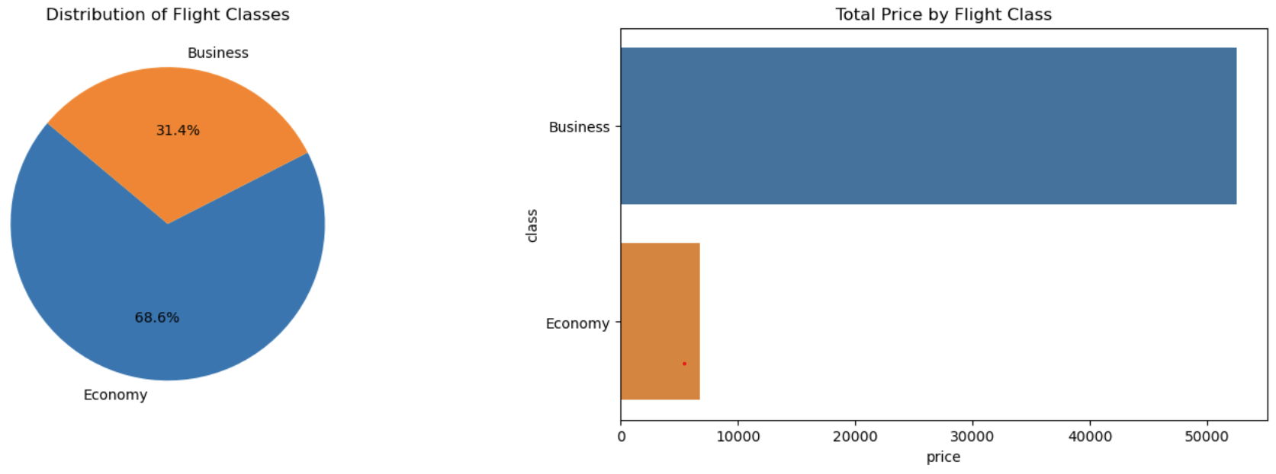
Blank slide
CHART
CLASS WISE ANALYSIS
Economy class have more bookings than Business Class
Business class have higher mean price than Economy Class

Slide 11
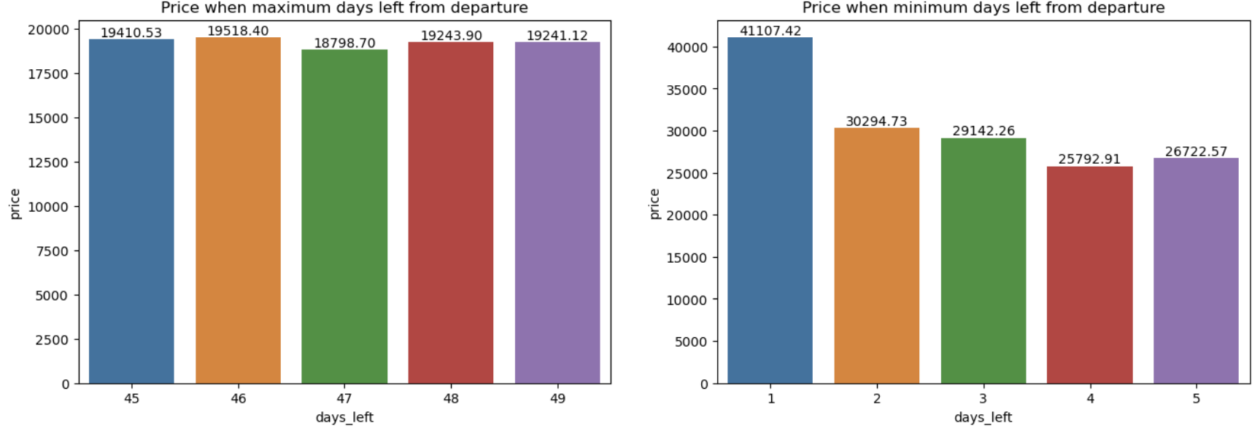
CHART
DAYS_LEFT WISE ANALYSIS
Mean Price is Higher when days_Left is low.
Mean price is lower when Days_Left is high.

Slide 12
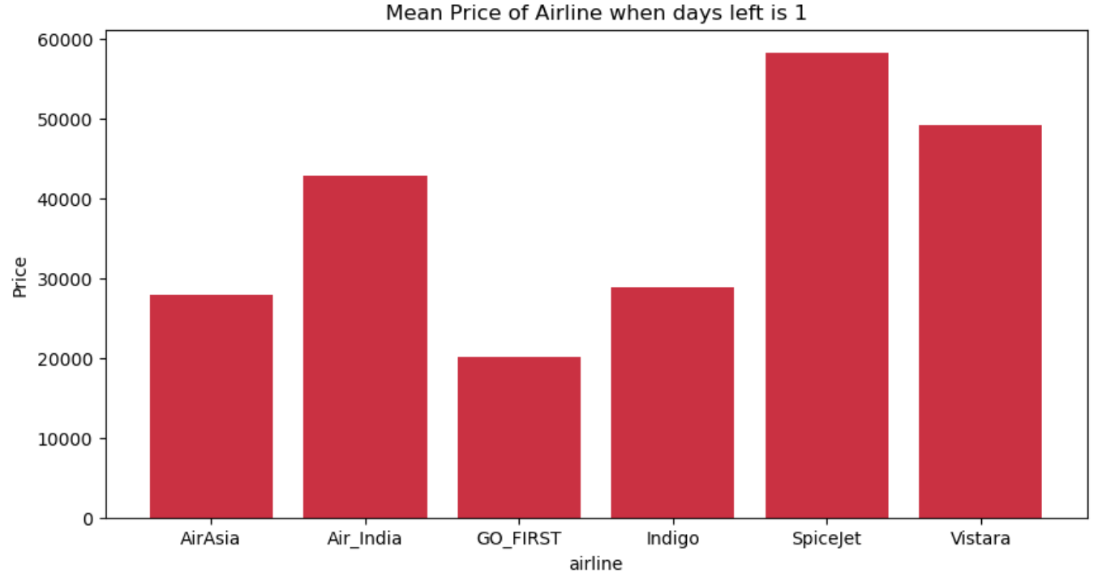
CHART
AIRLINE AND DAYS_LEFT(1) WISE ANALYSIS
Vistara charges highest when Days_Left is 1.
GO_First charge is lowest when Days_Left is 1.

Slide 13
OverALL FINDINGS AND IMPLICATIONS
Vistara operate maximum number of flights and their mean price is highest.
Economy Class have higher bookings and Business class have higher mean price.
Mean price of bookings closer to the departure day is higher and SpiceJet charge is highest when days left is 1.
Number of flights having 1 stop and their mean price is highest.
Those airline having less flight need to increase number of flights.
Last-minute bookings cost more, with SpiceJet maximizing revenue from urgent travelers, encouraging advance bookings for lower fares.
Companies needs to encourage Business Class Booking as its mean price is high.

Slide 14

Conclusion
Vistara operates the most flights with the highest mean price, indicating a strong market presence and premium services, while SpiceJet operates the least with a focused service strategy.
AirAsia has the lowest mean price, appealing to budget-conscious travelers, while Vistara targets premium segments with higher prices.
The Delhi-Hyderabad route is the least expensive, making it a cost-effective travel option, whereas the Bangalore-Chennai route is the most expensive, possibly due to high demand.
Most flights have one stop with the highest mean price, attracting convenience-seeking travelers, while night flights are the most expensive and late-night flights are the cheapest, appealing to budget travelers.

Slide 15
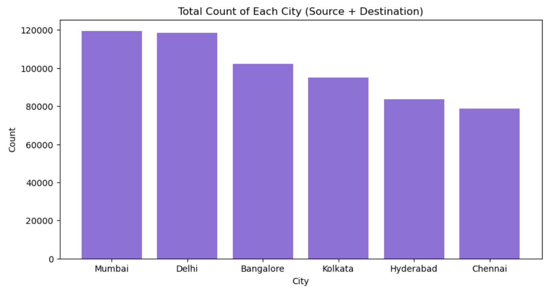
SOME OTHER ANALYSIS
BUSIEST AIRPORT ANALYSIS
CHART
Mumbai is the busiest airport in the country among top 6 airports
Chennai is least busiest airpost among top 6 airports

Slide 16
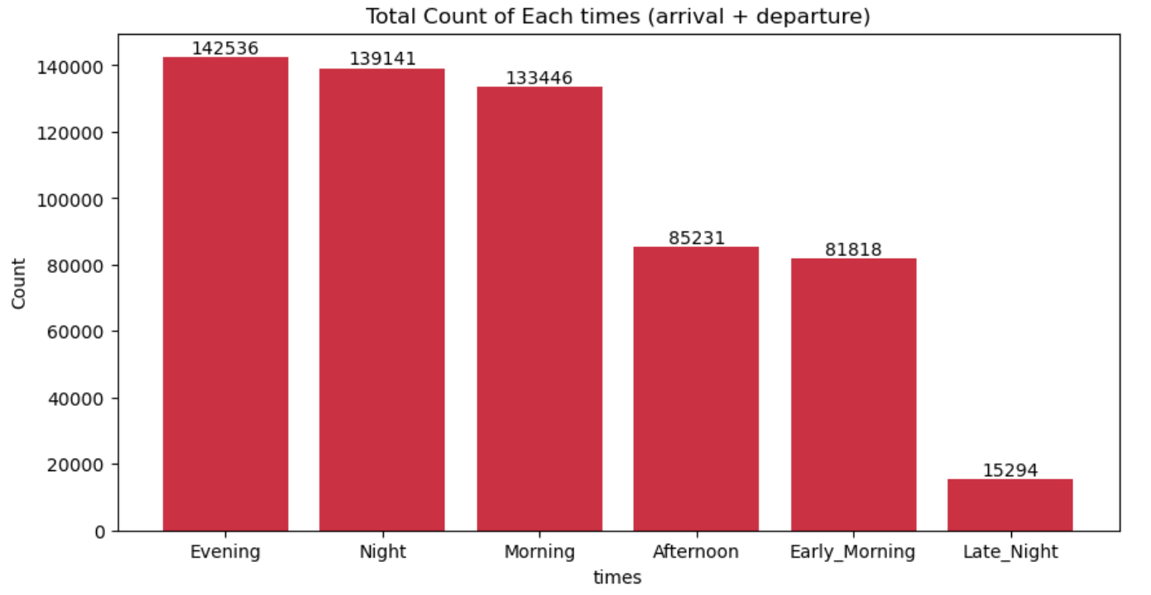
TIMES (OF DAY) WISE ANALYSIS
CHART
Flights starting and ending journey at Evening is highest.
Flights starting and ending journey at Late_Night is highest.

Slide 17
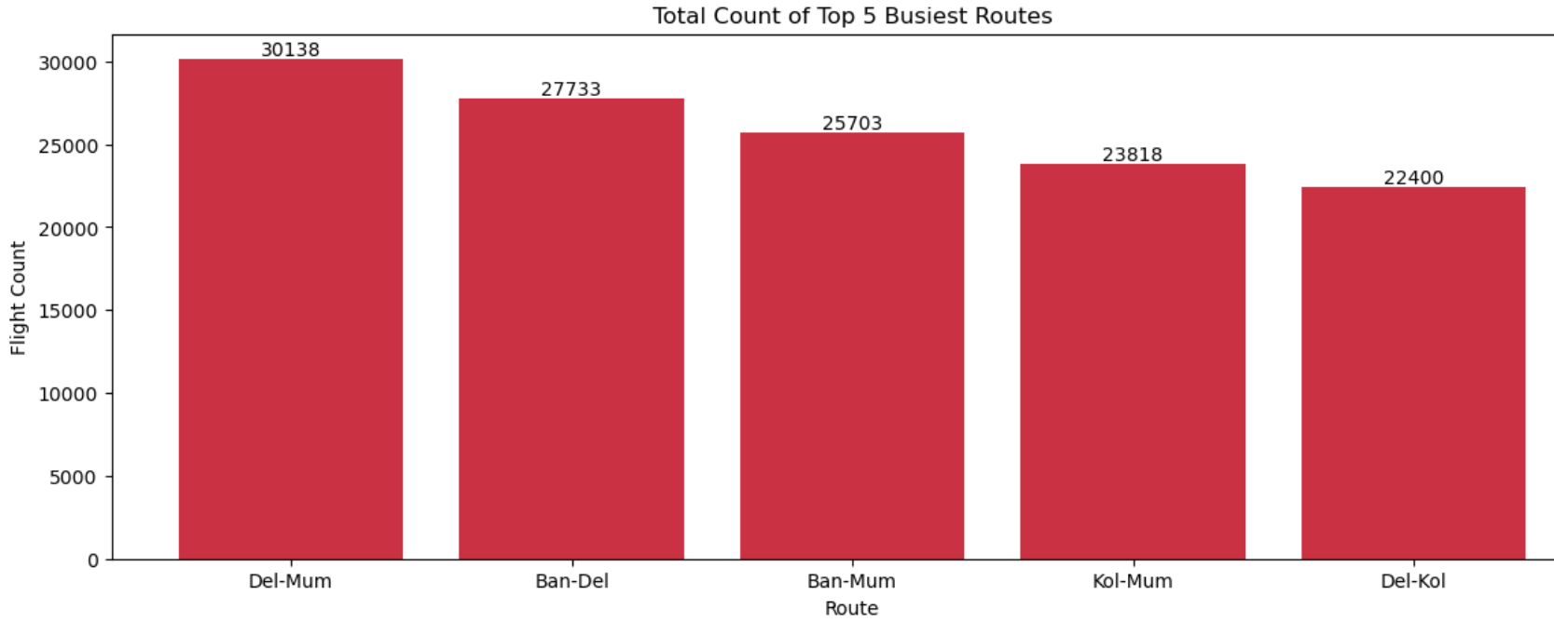
BUSIEST ROUTES ANALYSIS
CHART
Delhi – Mumbai is the busiest route among top 6.
Delhi - Kolkata is least busiest route among top 6.

